Slide 1

Event Processing Course
Event processing networks
(relates to chapter 6)

Slide 2
Lecture outline
Event processing network and its components
Event processing agents
Event channels
Global states

Slide 3
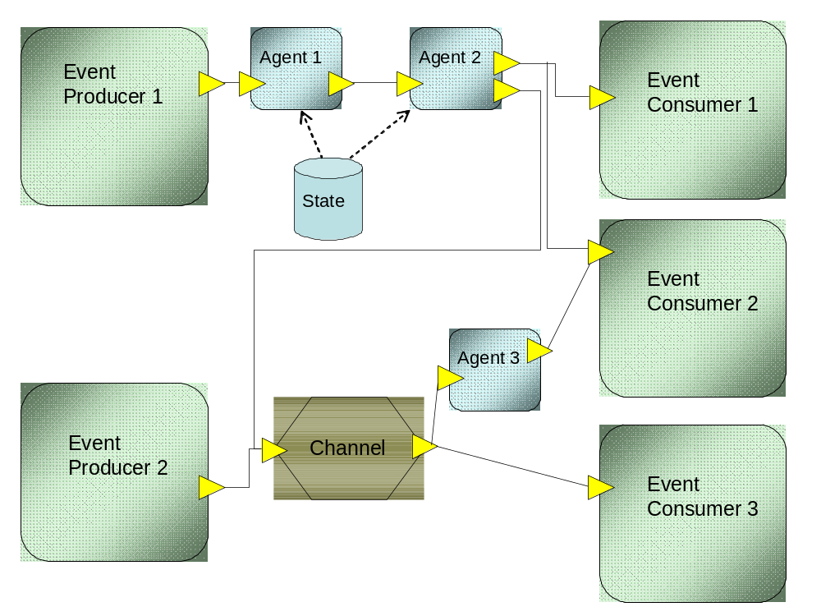
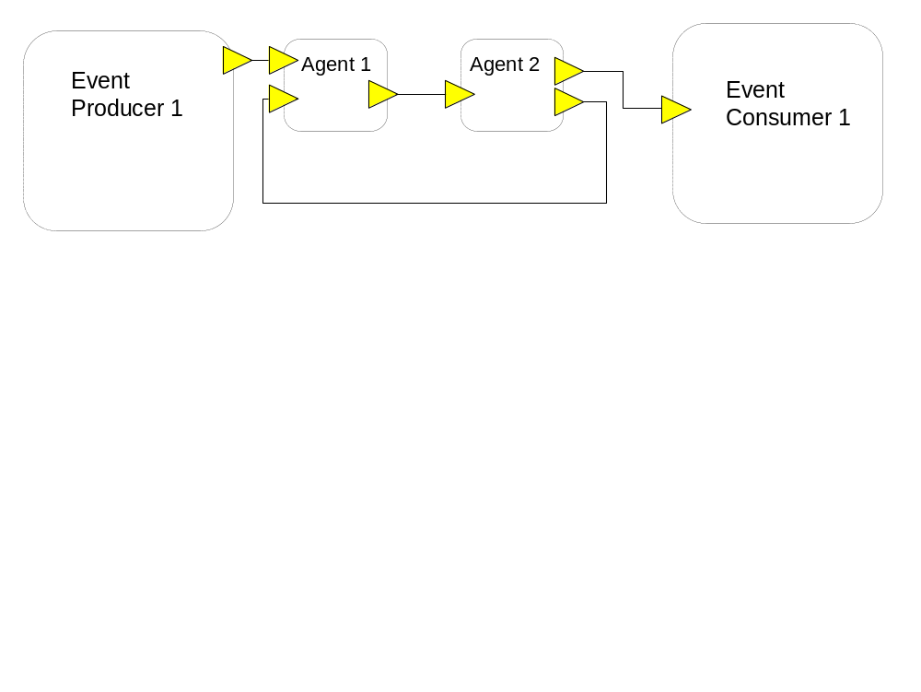
Event processing network
Link in the graph
means – event (or
stream) flowing from
the output terminal
to the input terminal
Connection can
be established
either by the source
or by the sink

Slide 4
Formal definition
EPN = (V, E) is a directed (possibly cyclic) graph
V = {C, P, EC, GS, EPA} where
  C = consumers, P = producers, EC = event channels, GS = global stores, EPA = Event Processing Agents
E = { (C, EC), (EC, EPA), (EC, P), (EPA, EC), (EPA, GS)}

Slide 5
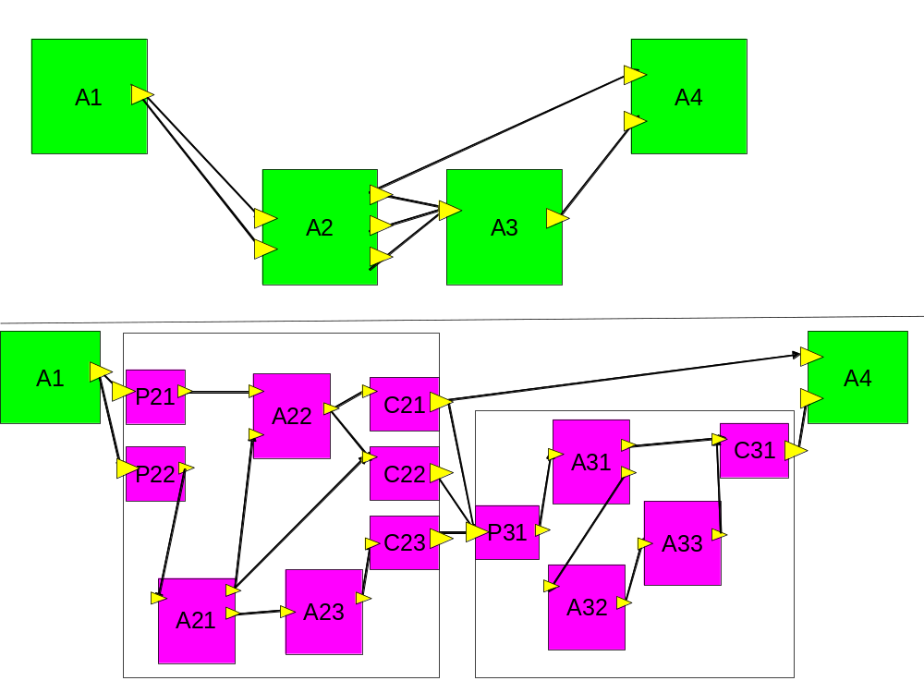
Recursive EPN

Slide 6
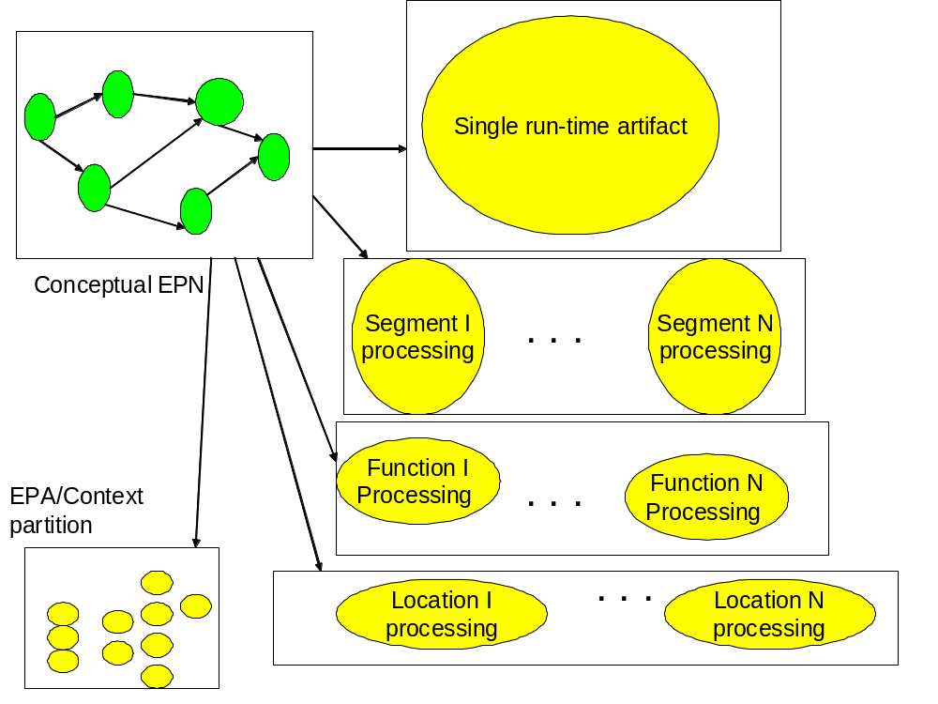
EPN implementation perspective

Slide 7
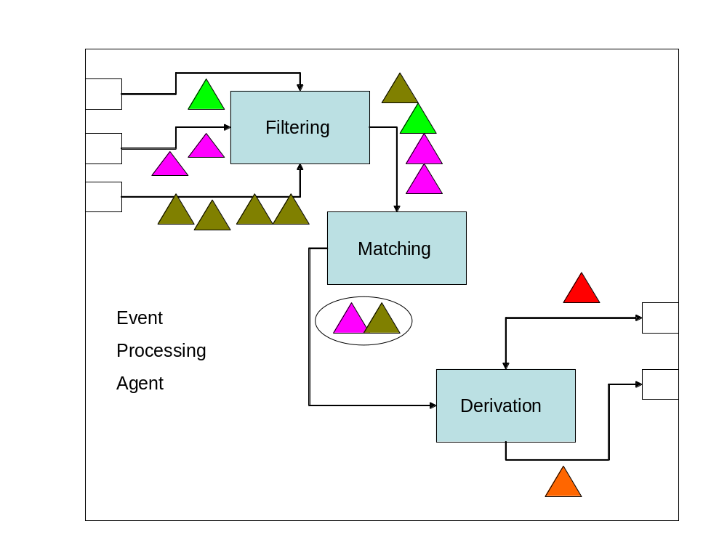
Event Processing Agent

Slide 8
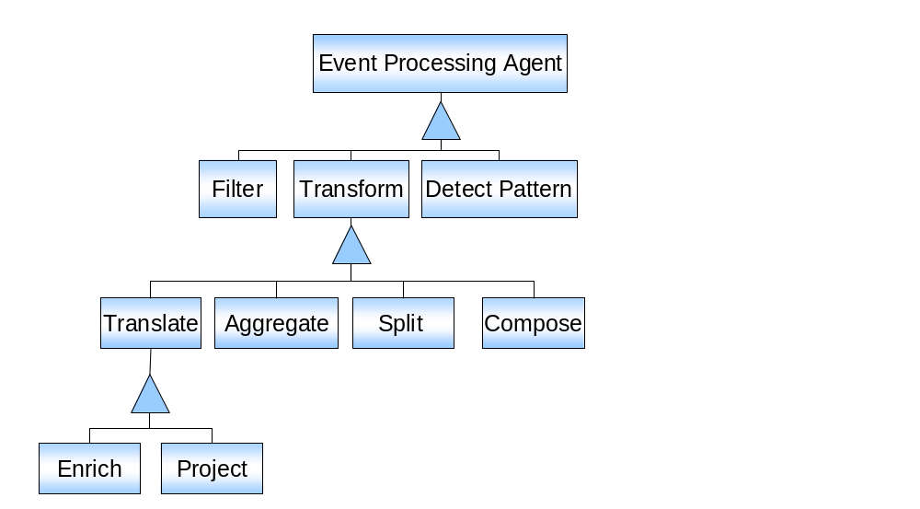
EPA types

Slide 9
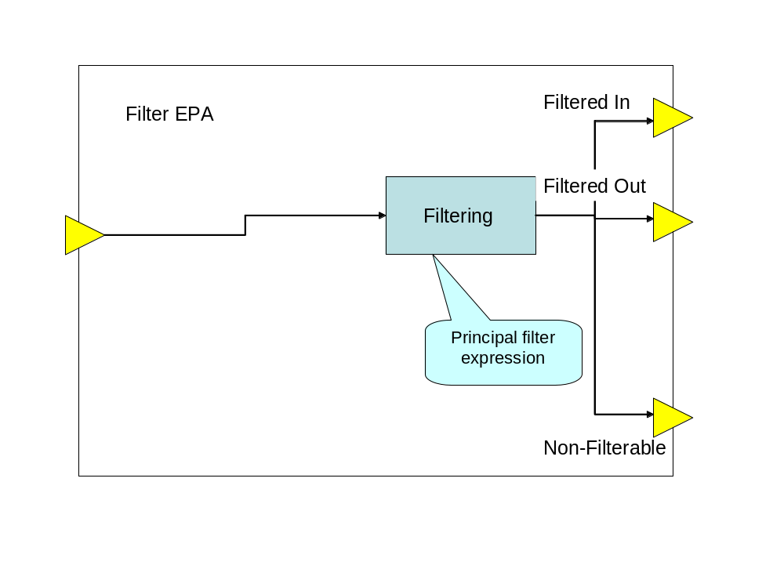
Filter EPA
A filter EPA is an EPA that performs filtering only, and has no matching or derivation steps, so it does not transform the input event.

Slide 10
Formal definition of Filter operation
Filter is a function that maps a single event ev to the set {TRUE, FALSE, UNDECIDED) relative to an assertion, such that:
  ev is mapped to TRUE, if ev satsifies the assertion
  ev is mapped to FALSE, if ev doesn’t satisfy the assertion
  ev is mapped to UNDECIDED, if is undecided whether ev satisfies the assertion
The event ev is unchanged.

Slide 11
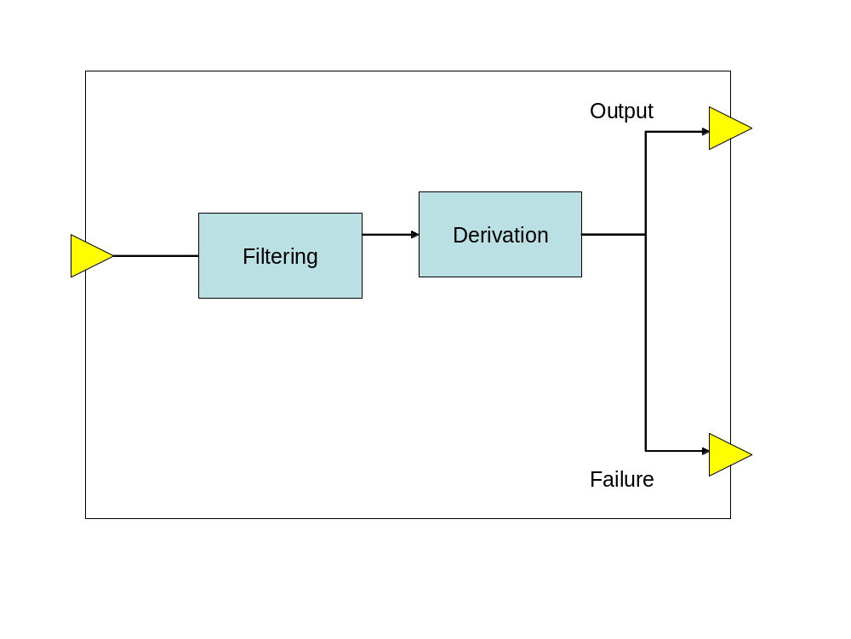
Transform EPA
A transform EPA is an EPA that performs the derivation function, and optionally also the filtering function

Slide 12
Formal definition of Transform operation
Transform is a function EV1 → Ev2 such that
  EV1 is a collection of input events
  Ev2 is a collection of output events
  The transform type and function determine the mapping from EP1 to EP2

Slide 13
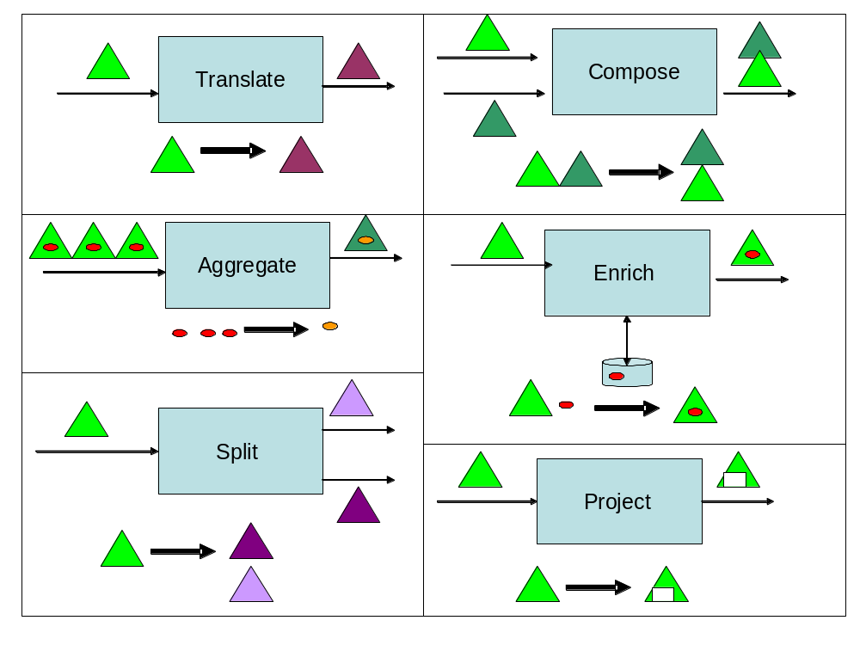
Transform EPA sub types

Slide 14
Transform EPA subtypes definitions
A translate EPA is a stateless transform EPA that takes as an input a single event, and generates a single derived event which is a function of the input event, using a translation formula.
An enrich EPA is a translate EPA that takes a single input event, matches it against a global state element, and creates a derived event which includes the original event, with possible modified attributes, and an additional collection of attributes {A1,…,An} copied or calculated as a result of using the global state.
A project EPA is a subtype of the translate EPA that takes an input event, and creates a single derived event that contains a subset of the attributes of the input event

Slide 15
Transform EPA subtype definitions (cont.)
An aggregate EPA is a transform EPA that takes as input a collection of events and creates a single derived event by applying an aggregation function over the input events.
A split EPA is a transform EPA that takes as an input a single event and creates a collection of events, each of them can be a clone of the original event, or a projection of that event containing a subset of its attributes
A compose EPA is a transform EPA that takes groups of events from different input terminals, looks for matches using some matching criterion and then creates derived events based on these matched events.
Pattern detection EPAs are discussed
In Lecture 6

Slide 16
Pattern detection EPA
A pattern detection EPA is an EPA that performs a pattern matching function on one or more input streams. It emits one or more derived events if it detects an occurrence of the specified pattern in the input events
Pattern detection EPAs are discussed
In Lecture 8

Slide 17
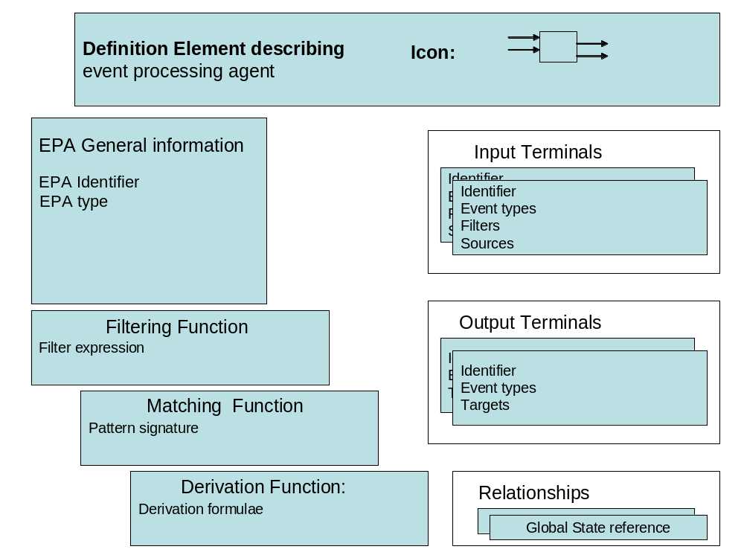
EPA Definition Elements

Slide 18
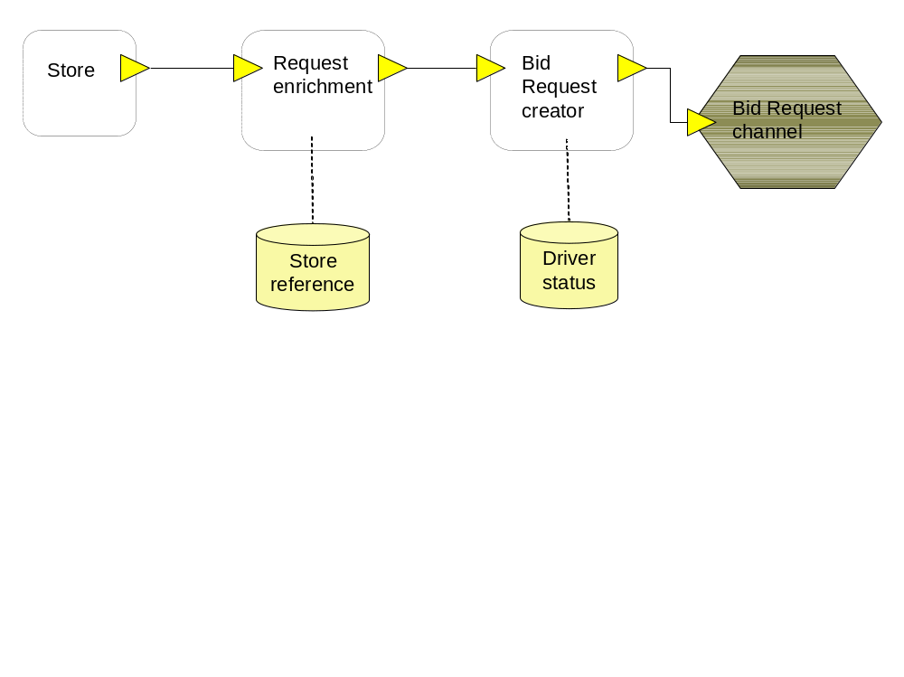
FFD EPN – The bid request system

Slide 19
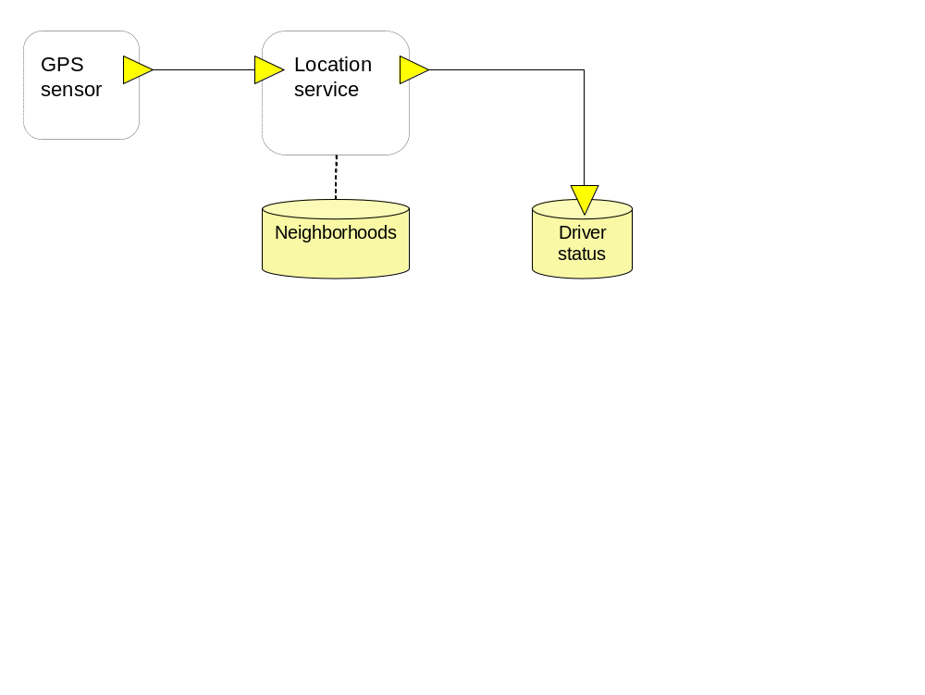
FFD EPN – The location identification

Slide 20
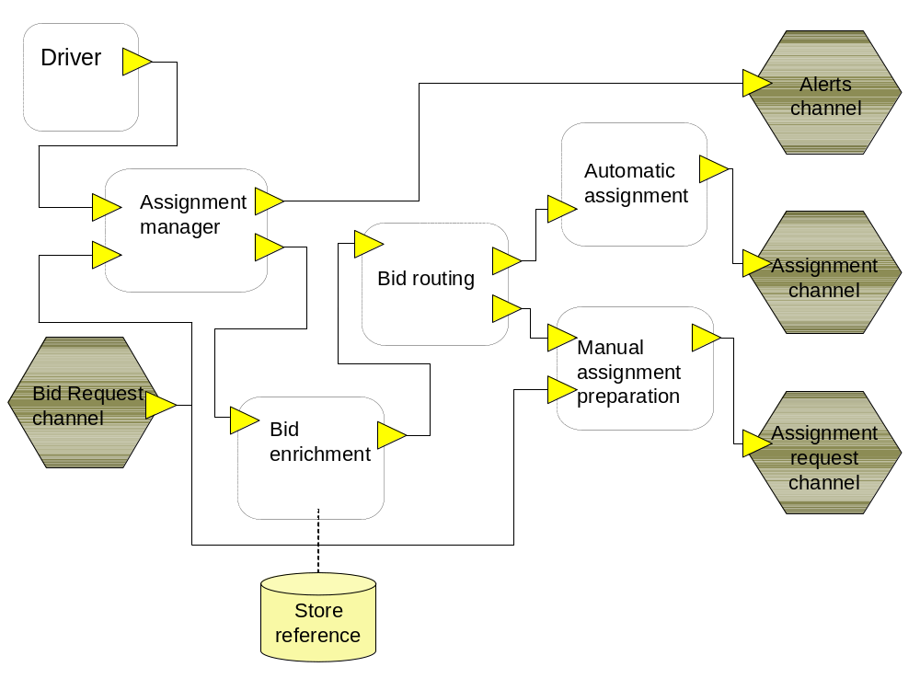
FFD EPN – The assignment system

Slide 21
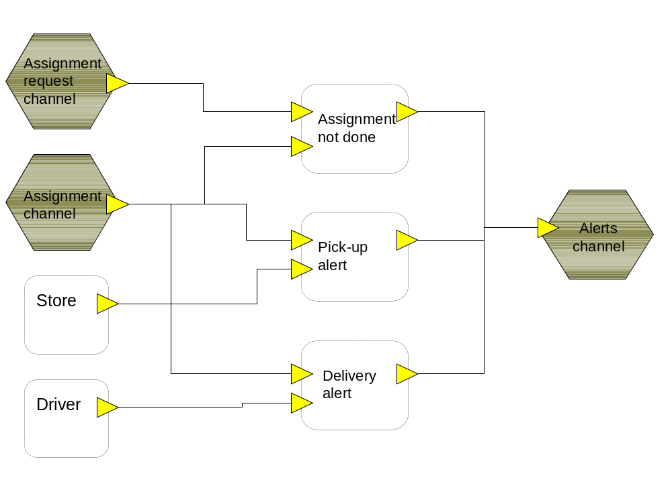
FFD EPN – The control system

Slide 22
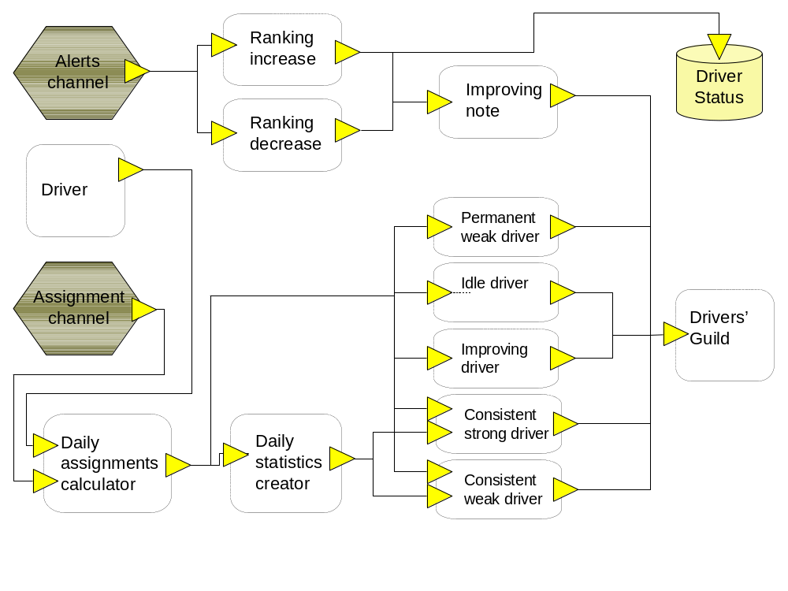
FFD EPN – The ranking and reporting system

Slide 23
Event Channel
An event channel is a processing element that receives
events from one or more source processing elements,
makes routing decisions, and sends the input events unchanged
to one or more target processing elements in accordance with these routing
decisions.

Slide 24
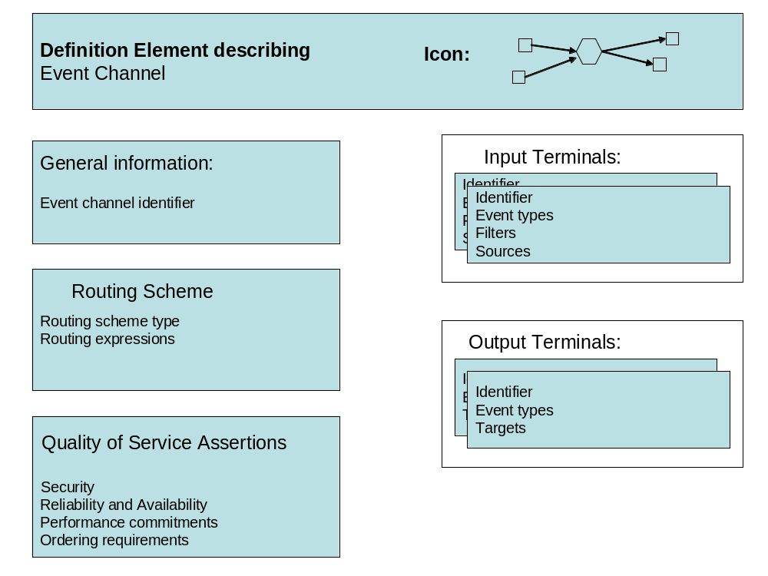
Event channels definition element

Slide 25
Formal definition of channel’s routing
Channel routing is a function that maps an event into To, where To is a collection of output terminals (without changing it).

Slide 26
Routing schemes
Fixed: The channel routes every event that it receives on any input terminal to every output terminal. In cases where there are multiple output terminals this means that separate copies of each input event are transmitted on each output terminal
Type-based: The channel makes routing decisions based on the event type of the event that is being routed.
Content-based: The routing decision is based on the event's content, this can be phrased as decision trees or decision tables, and are based on the input event content, as well as context information.

Slide 27
Global State
Historical events retained in an event store so that they can be processed at a later phase.
Reference data that event processing agents can access, for example to enrich or cleanse event data. Reference data is not maintained by the event processing system, but can affect the output of the event processing.
State of external entities that, like reference data, is not maintained by the event processing system but which can be used as part of processing events. Examples include: current state of a business process, an airport alert level, weather related states (sun, clouds, rain, snow…). This state could change as a result of a (raw or derived) event being processed by an event consumer.
Event processing state (whether persisted to disk or held in shared memory) that is accessible across event processing agents, and can be updated by an event processing application. This is typically maintained by the event processing platform.

Slide 28
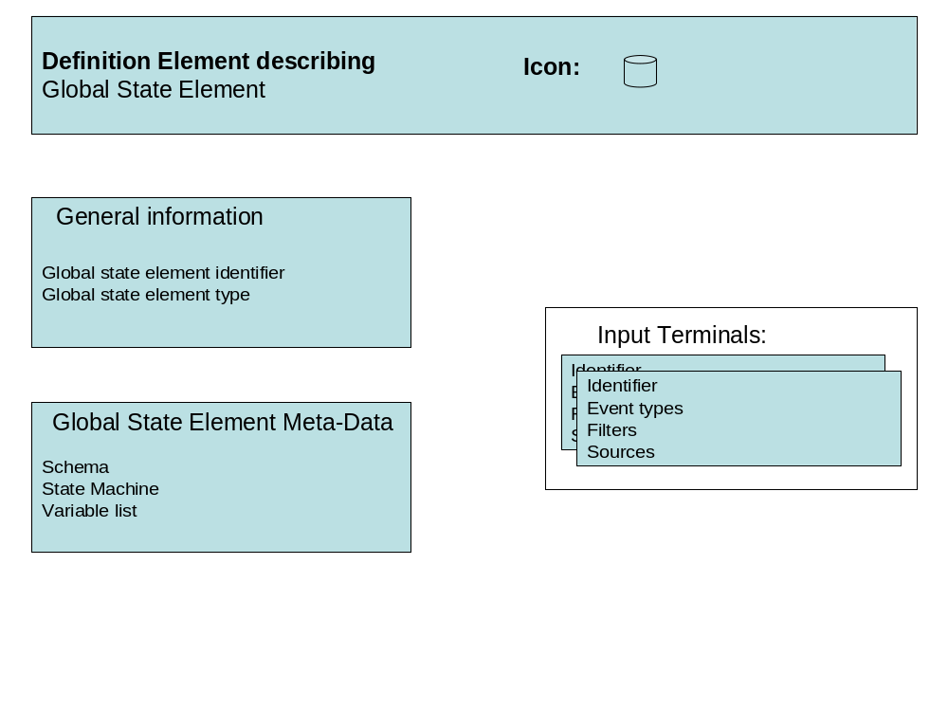
Global State Definition Element

Slide 29
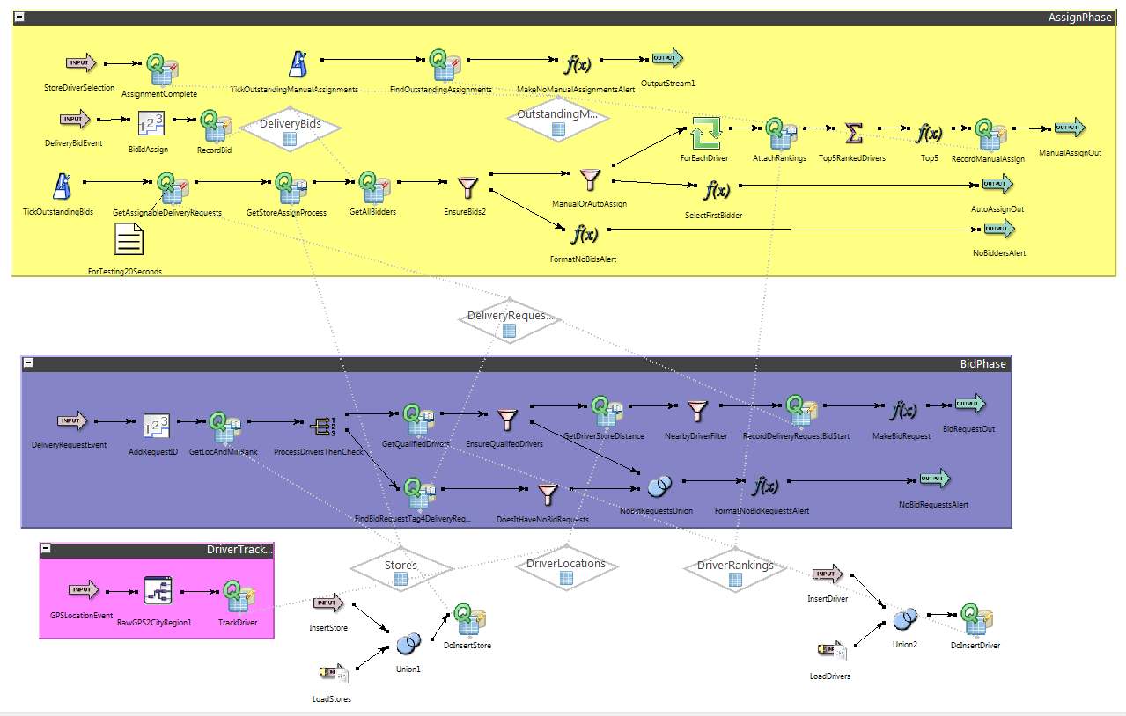
Streambase – event flow:

Slide 30
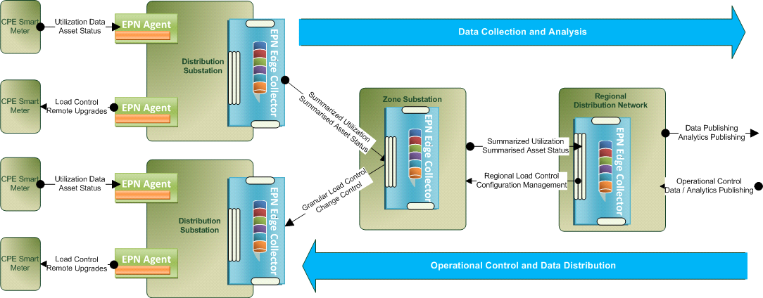
EPN – Event Zero

Slide 31
Lecture Summary
In this lecture we have discussed the following topics:
  The concept of event processing network
  EPA
  Channel
  Global state

